Slide 1
Tech2Teach
Educational and Social Services
for Highly Mobile Students
August 2021
Education Services for Students in Transition (Homeless, Foster Care, Military, Asylee, Refugee)
Every student a learner … Every learner a graduate … Every graduate a success!

Slide 2
Office of Special Programs Velma Salazar- Director Susana Villagran Majors – Case Manager Jo Ann Soliz – Case Manager Monica Vela – Administrative Assistant TBA – Data Clerk Phone: 361 878-2571 Fax: 361 844-0244 susana.majors@ccisd.us Instructional Resource Center (CIRC) 4321 Prescott Street, Room 107 Corpus Christi, TX 78416
Every student a learner … Every learner a graduate … Every graduate a success!

Slide 3
1. Welcome and Introductions 2. McKinney-Vento Homeless Assistance Act 3. Student Enrollment and Identification 4. McKinney-Vento Program Services 5. Dispute Resolution Process 6. Updates and Resources
Training Agenda
Every student a learner … Every learner a graduate … Every graduate a success!

Slide 4
McKinney-Vento Homeless Education Assistance Act defines and protects the rights of homeless students to enroll in, attend, and succeed in our public schools.
McKinney-Vento Act
Every student a learner … Every learner a graduate … Every graduate a success!

Slide 5
Definition of Homeless Children and Youth: Children and youth who lack a fixed, regular, and adequate nighttime residence are homeless. 11434a(2) Migratory children living in above circumstances.
Every student a learner … Every learner a graduate … Every graduate a success!

Slide 6
Sharing the housing of others due to loss of housing, economic hardship or similar reason Living in motels, hotels, trailer parks or camping grounds due to lack of alternative adequate housing Living in emergency or transitional shelters or substandard housing
Definition of Homelessness
Every student a learner … Every learner a graduate … Every graduate a success!

Slide 7
Doubled-Up Situations: - Where would you go if you couldn’t stay here? - What led you to move in to this situation? - Why did the family move in together? - How permanent is the arrangement? - Is it fixed, regular, and adequate?
Definition of Homelessness
Every student a learner … Every learner a graduate … Every graduate a success!

Slide 8
“Substandard” or Inadequate Housing Considerations: - Health and safety concerns - Number of occupants per square foot - Age of occupants - State and local building codes (Housing Standards or Building Codes criteria)
Definition of Homelessness
Every student a learner … Every learner a graduate … Every graduate a success!

Slide 9
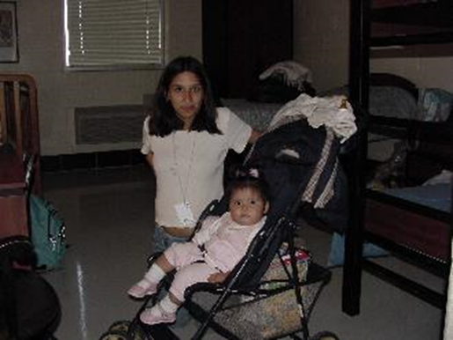
Use a Student Residency Questionnaire (SRQ) to determine or assess their living situation. While there is no time limit written into the law, situations need to be assessed on a case-by-case basis each academic year.
How long should a family
be considered homeless?
Every student a learner … Every learner a graduate … Every graduate a success!

Slide 10
The McKinney-Vento Act defines an “unaccompanied youth” as a youth that is not in the physical custody of a parent or guardian. “Guardian” is a legal designation representing the person who has legal custody of a student; this designation can only be granted to someone other than a birth parent by a judge in a court of law.
Unaccompanied Youth
Every student a learner … Every learner a graduate … Every graduate a success!

Slide 11
These documents do NOT convey legal guardianship: - Power of Attorney - Educational Affidavit - Notarized letter pertaining to student’s care - Family Protective Services Safety Plan
Unaccompanied Homeless Youth
Every student a learner … Every learner a graduate … Every graduate a success!

Slide 12
Students of all ages may be unaccompanied. The Texas Education Agency defines a youth to be a person who is under age 21 on September 1 of the applicable school year. For students eligible for special education services, under age 22 on September 1 of the applicable school year, not a high school graduate.
Unaccompanied Youth Age Limits
Every student a learner … Every learner a graduate … Every graduate a success!

Slide 13
- Immigrant students may be considered homeless if they meet the definition of homeless. - Under the United States Supreme Court decision in Plyer v. Doe, 102 S.Ct. 2382 (1982), a student’s immigration status is not a permissible basis for denying admission to a public school.
Other Student Situations
Every student a learner … Every learner a graduate … Every graduate a success!

Slide 14
People outside of the United States must apply for refugee status. Refugees-individuals admitted into the U.S. under Section 207 of the Immigration and Nationality Act and are determined to be refugees before arriving in the U.S.
Refugee
Every student a learner … Every learner a graduate … Every graduate a success!

Slide 15
People who have already made it to the United States border or the interior (perhaps by using a visa or by entering illegally) can apply for asylum status. Once these individuals arrive in the United States, they can request asylum. While their case is being decided they are known as asylum seekers.
Asylum Seeker
Every student a learner … Every learner a graduate … Every graduate a success!

Slide 16
Support Services
Students in Transition Identified | 2020-2021 | 2019-2020 | 2018-2019
Homeless | 917 | 912 | 1,383
Unaccompanied Homeless Youth | 160 | 86 | 266
Unaccompanied Youth Not Homeless | 34 | 123 | 84
Foster Care | 147 | 85 | 89
Military Connected | 692 | 705 | 560
Asylee & Refugee | 12 | 4 | 2
Total Students in Transition | 1,790 | 1,825 | 2,116
Every student a learner … Every learner a graduate … Every graduate a success!

Slide 17
2020-2021 Homeless Students
Campus | Total | Campus | Total | Campus | Total | Campus | Total
001-CARROLL | 32 | 049-HAMLIN | 12 | 117-HOUSTON | 10 | 141-YEAGER | 12
002-KING | 34 | 050-MARTIN | 12 | 118-KOSTORYZ | 9 | 142-ZAVALA | 20
003-MILLER | 54 | 054-SSC | 2 | 121-LOS ENCINO | 9 | 143-MARY GRETT | 2
004-MOODY | 43 | 055-KAFFIE | 10 | 122-SHAW | 20 | 146-CLUB EST | 8
005-RAY | 40 | 056-GRANT | 9 | 123-MEADOWBRK | 15 | 148-MOORE | 13
008-COLLEGIATE | 10 | 057-ADKINS | 13 | 124-MENGER | 9 | 149-MIRELES | 7
009-COLES | 44 | 101-ALLEN | 4 | 125-MONTCLAIR | 10 | 150-GALVAN | 7
012-JJAEP | 1 | 104-BERLANGA | 23 | 127-OAK PARK | 37 | 151-JONES | 9
014-BRANCH | 6 | 106-HICKS | 7 | 130-SANDERS | 2 | 152-BARNES | 17
015-VETERANS | 26 | 107-Wynn Seale | 5 | 132-SCHANEN | 7 | 153-ECDC | 4
041-BAKER | 25 | 108-CROCKETT | 13 | 134-SMITH | 21 | 154-DAWSON | 6
043-BROWNE | 16 | 110-EVANS | 29 | 136-TRAVIS | 15 | 157-WEBB | 5
046-CMS@SP | 44 | 111-FANNIN | 21 | 138-CALK-WILSN | 23 | 158-KOLDA | 6
047-DRISCOLL | 29 | 115-GARCIA | 16 | 139-WINDSOR PK | 5
048-HAAS | 9 | 116-GIBSON | 13 | 140-WOODLAWN | 7 | Grand Total | 917
Every student a learner … Every learner a graduate … Every graduate a success!

Slide 18
The McKinney-Vento Act requires public LEAs to identify children and youth in homeless situations. Student Residency Questionnaire (SRQ) All eligible students must be reported Schools must do outreach to find students experiencing homelessness
Identification = Eligibility
Every student a learner … Every learner a graduate … Every graduate a success!

Slide 19
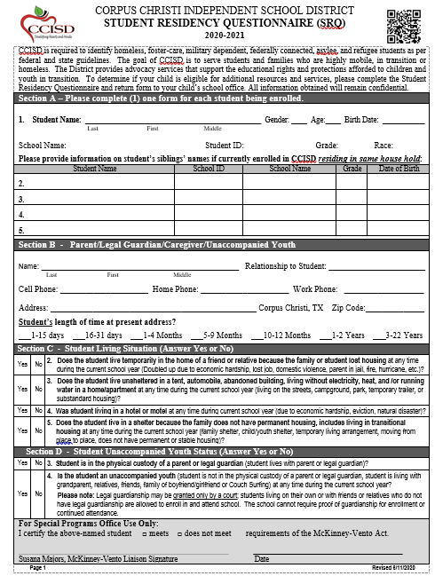
The SRQ is included in the Online-Enrollment process.
Students who become homeless during school year, will need to fill out the SRQ.

Slide 20
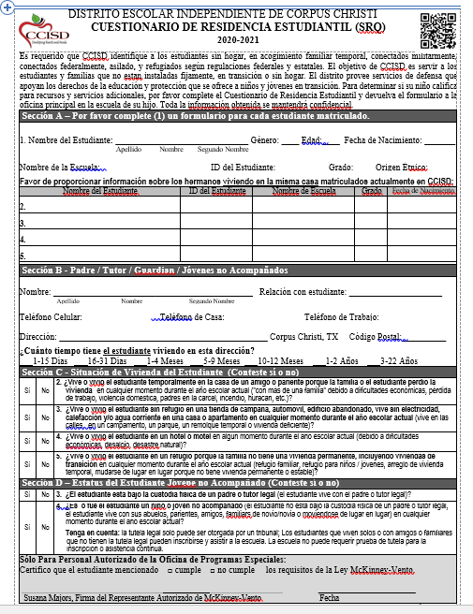
If any boxes from Section C-H were answered “YES”, fax the completed SRQ form to 844-0244 or email to:
Susana.Majors@ccisd.us
and cc:
Monica.Vela@ccisd.us

Slide 21
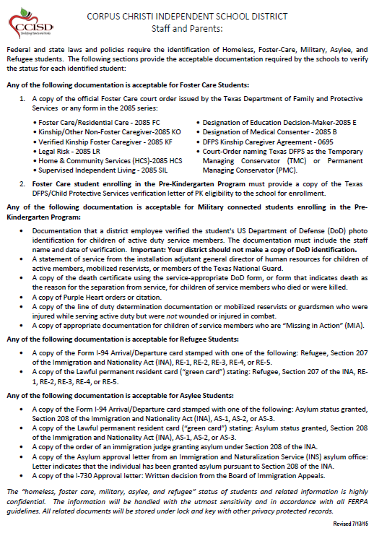

Slide 22
McKinney Vento Act & Fostering Connections Act were Amended by the Every Student Succeeds Act of 2015
Educational Rights for Students
Every student a learner … Every learner a graduate … Every graduate a success!
Notes:
Facilitate Pre-K and Head start enrollment

Slide 23
- Immediately enroll homeless unaccompanied students even if they have no legal guardian. - Immediately enroll homeless students even if they have no proof of residency. - Immediately enroll without the usual documents, homeless families and youth cannot be required to complete or sign guardianship forms or a dual residency affidavits.
Immediate Enrollment
Every student a learner … Every learner a graduate … Every graduate a success!
Notes:
Facilitate Pre-K and Head start enrollment

Slide 24
- Waive deadlines if students have missed application or enrollment deadlines during any period of homelessness. - Immediately enroll because school is the safest place for a runaway, homeless or potentially trafficked youth. - Immediate enrollment applies to homeless unaccompanied youth, even without parent or guardian. 11432(g)(1)(H)(iv)
Enrollment (cont.)
Every student a learner … Every learner a graduate … Every graduate a success!
Notes:
Facilitate Pre-K and Head start enrollment

Slide 25
The Act does not prohibit LEAs from requiring parents or guardians to submit contact information. McV Sec. 722(g)(3)(H) A school district cannot require a caregiver to obtain legal guardianship at any point prior to or following an unaccompanied homeless youth’s school enrollment, nor can it discontinue a student’s enrollment due to an inability to identify a caregiver, guardian, or parent, or produce proof of guardianship.
Enrollment
Every student a learner … Every learner a graduate … Every graduate a success!

Slide 26
Homeless students have two school selection options under McKinney-Vento: 1. School of Origin: School the student attended when permanently housed or school in which the student was last enrolled. ESSA has expanded the school of origin definition to include preschool and feeder pattern (receiving) schools. 2. Local Attendance Area School: Any public school that non-homeless students living in the attendance area in which the child/youth is actually living are eligible to attend.
School Selection
Every student a learner … Every learner a graduate … Every graduate a success!
Notes:
Facilitate Pre-K and Head start enrollment

Slide 27
Texas provides a third option, TEC 25.001(b)(5), for students in homeless situations: A homeless family or youth may choose to attend any district in the state: - Not dependent on residency of student, guardian(s), or parent(s) - The district chooses the campus - Transportation is not mandated TEC 29.153(b) provides similar admission to a prekindergarten class if the child is at least three and homeless.
School Selection
Every student a learner … Every learner a graduate … Every graduate a success!
Notes:
Facilitate Pre-K and Head start enrollment

Slide 28
Students may stay in their school of origin: - For the duration of their homelessness - Until the end of the academic year in which they find permanent housing - When becoming homeless in between academic years - School of origin definition includes receiving schools (feeder pattern school).
School Selection
Every student a learner … Every learner a graduate … Every graduate a success!
Notes:
Facilitate Pre-K and Head start enrollment

Slide 29
In determining the school that is in a student’s best interest to attend, LEAs must: - Make a best interest determination, with a presumption that staying in the school of origin is in the student’s best interest unless it is against the wishes of the parent, guardian, or unaccompanied youth - Consider student-centered factors, including the impact of mobility on achievement, education, health, safety, and educational supports
Best Interest Determinations
Every student a learner … Every learner a graduate … Every graduate a success!
Notes:
Facilitate Pre-K and Head start enrollment

Slide 30
LEAs also must provide students in homeless situations with transportation services comparable to those provided to other students. 11432(g)(4)(A) LEAs must eliminate barriers to the identification, enrollment and retention of students experiencing homelessness (including transportation barriers). 11432(g)(1)(I)
Transportation – Key Provisions
Every student a learner … Every learner a graduate … Every graduate a success!
Notes:
Facilitate Pre-K and Head start enrollment

Slide 31
If a dispute arises over eligibility, school selection or enrollment in a school: 11432(g)(3)(E) • The student shall be immediately enrolled in the school in which enrollment is sought, pending resolution of the dispute (including all available appeals). • The parent, guardian or unaccompanied youth must be provided a written explanation of decisions made by the school, LEA or SEA, and how to appeal them.
Dispute Resolution
Every student a learner … Every learner a graduate … Every graduate a success!
Notes:
Facilitate Pre-K and Head start enrollment

Slide 32
Child/Youth whom CPS has taken legal control over via court proceeding – Permanent or Temporary Managing Conservatorship (TMC or PMC) Does not include voluntary placement with safety plan
What is a foster child?
Every student a learner … Every learner a graduate … Every graduate a success!

Slide 33
Substitute Care = Care outside immediate family Formal processes - not homeless (foster home, group home, residential treatment centers, kinship care, adoption, legal guardianship) HHSC Form 2085 Informal processes – homeless (relative care, non-relative care, shelter care, transitional living, unaccompanied youth who meet M-V guidelines, CPS-safety plan)
Foster and Substitute Care
Every student a learner … Every learner a graduate … Every graduate a success!

Slide 34
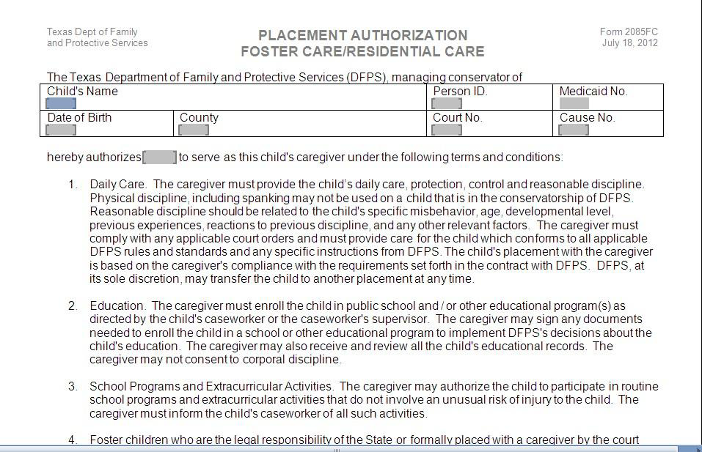
DFPS Form 2085

Slide 35
The Compact provides for the uniform treatment of military children transferring between school districts and states. What Children are Eligible for Assistance Under the Compact? 1. Active duty members of the uniformed services, National Guard and Reserve on active duty orders 2. Members or veterans who are medically discharged or retired for (1) year 3. Members who die on active duty
Interstate Compact on Educational
Opportunity for Military Children
Every student a learner … Every learner a graduate … Every graduate a success!
Notes:
Facilitate Pre-K and Head start enrollment

Slide 36
Educational Issues that the Compact Covers: Enrollment • Educational Records • Immunizations • Kindergarten & First Grade Entrance Age Placement & Attendance • Course & Educational Program Placement • Special Education Services • Placement Flexibility • Absence Related to Deployment Activities
Interstate Compact on Educational
Opportunity for Military Children
Every student a learner … Every learner a graduate … Every graduate a success!
Notes:
Facilitate Pre-K and Head start enrollment

Slide 37
Eligibility • Eligibility for Student Enrollment • Eligibility for Extracurricular Participation Graduation • Waiving courses required for graduation if similar course work has been completed • Flexibility in accepting state exit or end-of-course exams, national achievement tests, or alternative testing in lieu of testing requirements for graduation in the receiving state • Allowing a student to receive a diploma from the sending school instead of the receiving school
Interstate Compact on Educational
Opportunity for Military Children
Every student a learner … Every learner a graduate … Every graduate a success!
Notes:
Facilitate Pre-K and Head start enrollment

Slide 38
• Homeless Shelter Tutorial Program • Truancy Prevention/Drop-out Recovery • Child Nutrition Program • Enrollment and Withdraw Assistance • Transportation/Bus Passes • Immunization or School Records
Educational Support Services
Every student a learner … Every learner a graduate … Every graduate a success!
Notes:
Facilitate Pre-K and Head start enrollment

Slide 39
• Pre-Kindergarten/Head Start • Graduation Waiver Requirements • College Round-Up • Unaccompanied Youth Verification Letters • FAFSA Application Assistance • School Birth Certificate • Immunizations
Educational Support Services
Every student a learner … Every learner a graduate … Every graduate a success!
Notes:
Birth certificate and immunizations assistance for homeless only.

Slide 40
• Teen Table (School Food Pantry) • Clean Kids Closet (Toiletries) • Clothes Closet / Shoes/ Jackets • School Supplies • School Uniform • Holiday Food Baskets • Fees/Fines (Lost Textbooks, Testing, Fees, Broken Equipment)
Service Immediate Needs
Every student a learner … Every learner a graduate … Every graduate a success!
Notes:
Nurses are welcome to call homeless services for lice issues.

Slide 41
• SSI/SSDI Application • Medicaid/CHIP Application • TANF Application • SNAP Application • Cell Phone Application • DACA, VAWA Self Petition, U-Visa, T-Visa Applications
Social Services
Every student a learner … Every learner a graduate … Every graduate a success!
Notes:
Online Services

Slide 42
• Emergency Shelter Referral • Non-Emergency Housing Referral • Emergency Utility Assistance • Health Service Referral • Medical Transportation Referral • Transportation for Out of City/State • Community Agency Referral
Community Referrals
Every student a learner … Every learner a graduate … Every graduate a success!

Slide 43
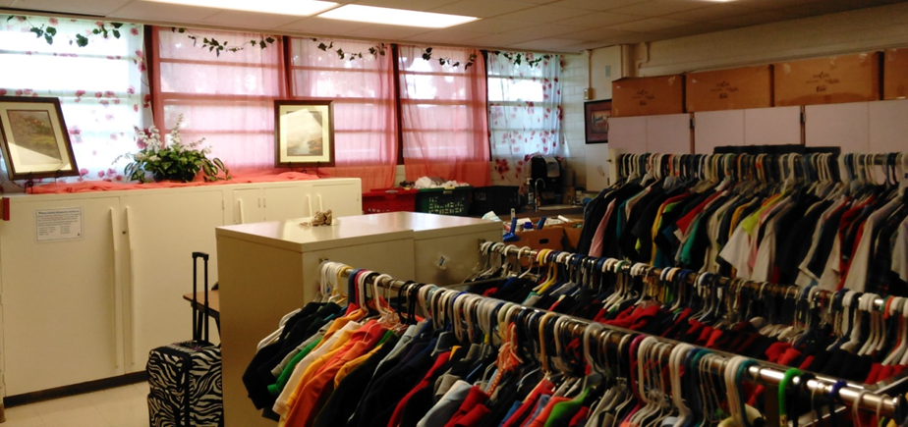
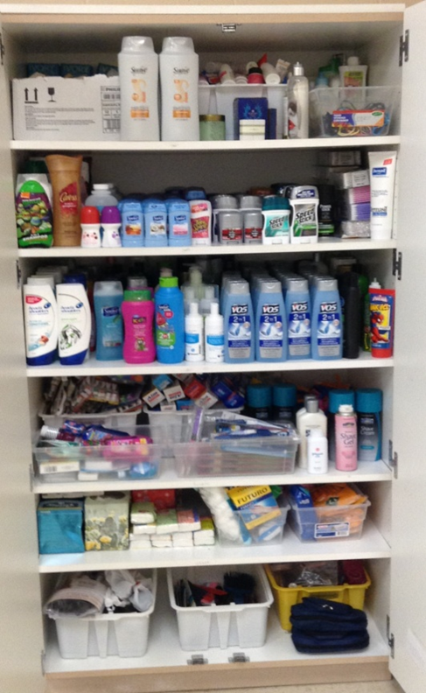
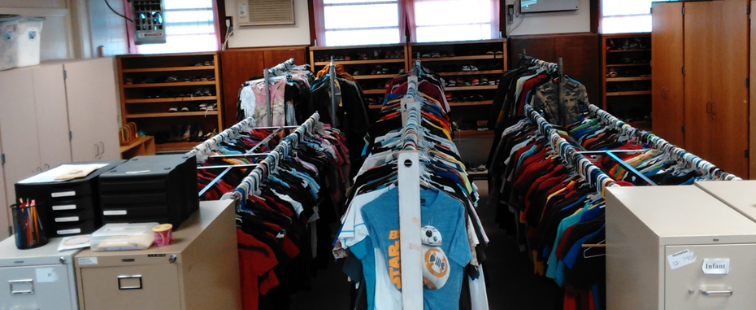
Donation Room
Every student a learner … Every learner a graduate … Every graduate a success!

Slide 44
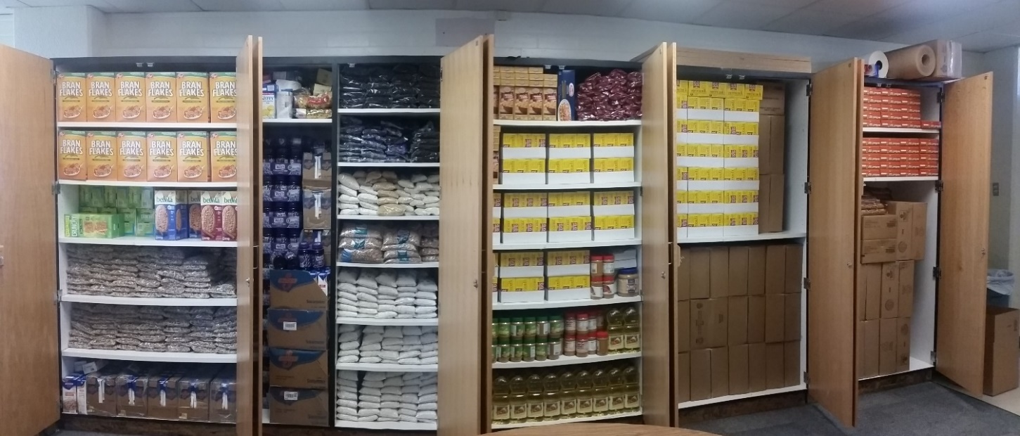
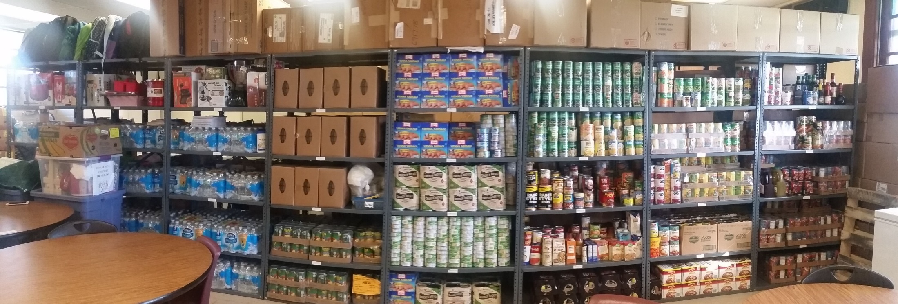
Kids Table
Every student a learner … Every learner a graduate … Every graduate a success!

Slide 45
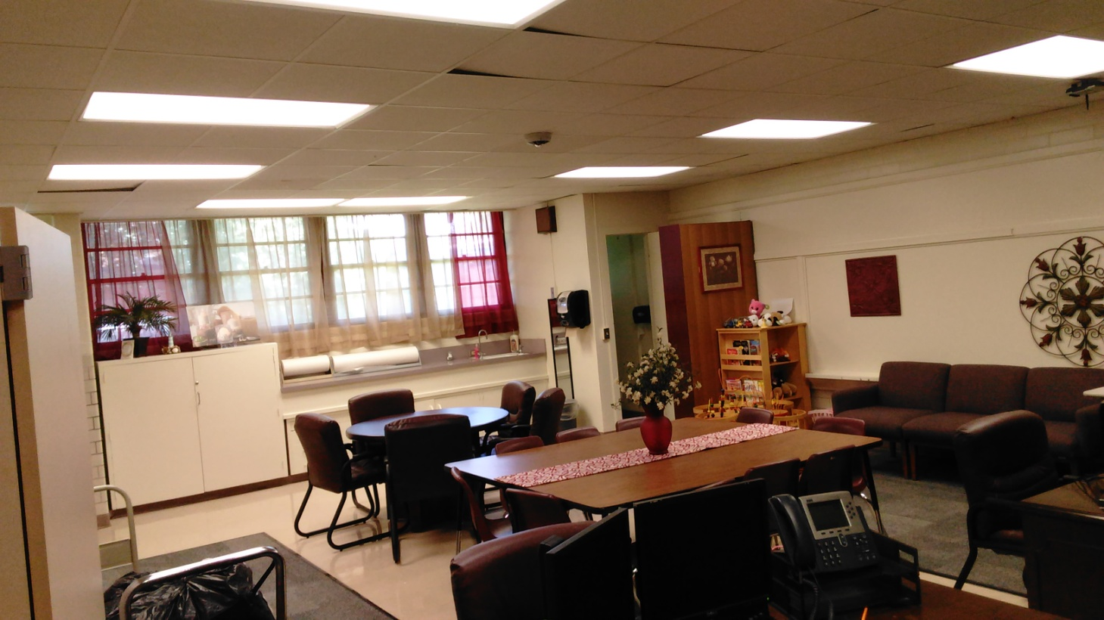
Meeting Rooms
Every student a learner … Every learner a graduate … Every graduate a success!

Slide 46
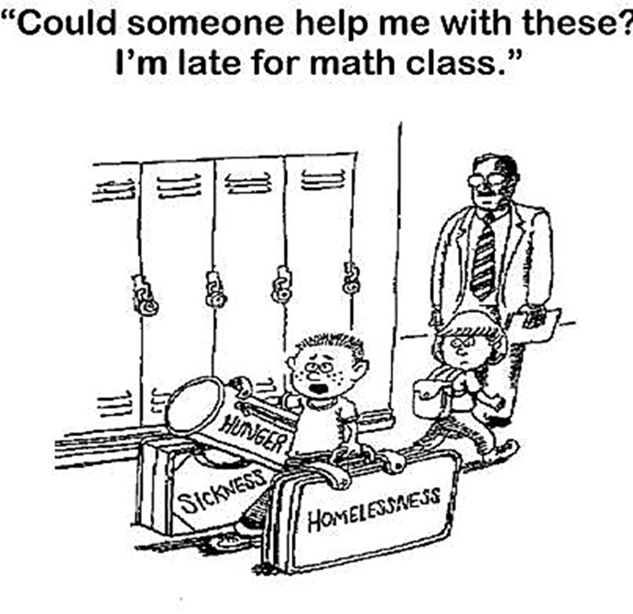
Questions/Comments
Every student a learner … Every learner a graduate … Every graduate a success!

